Slide 1

7th Grade Math
Unit 9, Lesson 4 Adding and Subtracting Expressions with Rational Coefficients Volume 2, pg. 57

Slide 2


Benchmark
MA.7.AR.1.1
Apply properties of operations to add and subtract linear expressions with rational coefficients.
volume 2, pg. 57

Slide 3
Integrated Mathematical Thinking and Reasoning Standards
MA.K12.MTR.3.1 Complete tasks with mathematical fluency.
MA.K12.MTR.4.1 Engage in discussions that reflect on the mathematical thinking of self and others.
volume 2, pg. 57

Slide 4

Learning Target
I can apply properties of operations to add and subtract linear expressions with rational coefficients.
volume 2, pg. 57

Slide 5

Warm-Up
volume 2, pg. 58

Slide 6

9.4.1 Warm-Up: Bell Work
Rewrite each expression by combining like terms.
$5.7x − (3.5x + 6)$
$(−\frac{5}{6} y + 5\frac{1}{2}) − (\frac{2}{3}y + 34)$
volume 2, pg. 58

Slide 7

Collaboration
volume 2, pg. 58

Slide 8

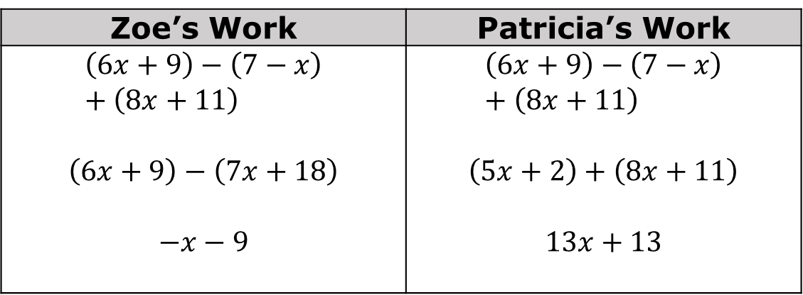
9.4.2 Collaboration: Adding and Subtracting Linear Expressions
Two students made errors when rewriting the expression $(6x+9)−(7−x)+(8x+11)$.
Zoe’s Work | Patricia’s Work
$$\left(6x+9\right)−\left(7−x\right)+\left(8x+11\right)$$ $$\left(6x+9\right)−\left(7x+18\right)$$ $$−x−9$$ | $$\left(6x+9\right)−\left(7−x\right)+\left(8x+11\right)$$ $$\left(5x+2\right)+\left(8x+11\right)$$ $$13x+13$$
volume 2, pg. 58

Slide 9
Working with your partner, write an explanation to Zoe that describes her error.
Write an explanation to Patricia that describes her error.
volume 2, pg. 58

Slide 10
Simplify the expression $(6x+9)−(7−x)+(8x+11)$.
volume 2, pg. 59

Slide 11

Guided Practice
volume 2, pg. 59

Slide 12

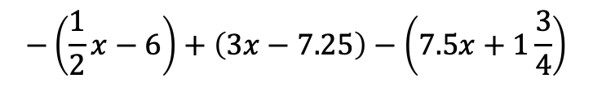

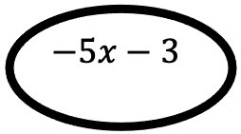

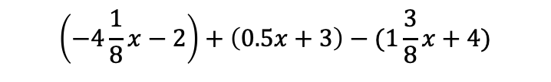
9.4.3 Guided Practice: Equivalent Expressions
Circle the expressions that are equivalent to $−5x−3$and cross out those that are not.
$$\left(−4\frac{1}{8}x−2\right)+\left(0.5x+3\right)−(1\frac{3}{8}x+4)$$
$$−2x−(8x+5)+(x+2 )$$
$$−5x−3$$
$$\left(7x+4\right)−(3x+2)+(−9x−9 )$$
$$−\left(\frac{1}{2}x−6\right)+\left(3x−7.25\right)−\left(7.5x+1\frac{3}{4}\right)$$
volume 2, pg. 59

Slide 13

Your Turn
volume 2, pg. 60

Slide 14

9.4.4 Your Turn!
Rewrite each expression by combining like terms.
$(1 − 4y) − (2.5y + 7) − (− 0.3y + 3)$
$(3 \frac{1}{2} x − 4) + (x − 3.2) − (−\frac{1}{4}x + 9)$
$−(2r + 5) − (6 − 3r) + (10r − 4)$
volume 2, pg. 60

Slide 15

Wrap-Up
volume 2, pg. 60

Slide 16
9.4.5 Wrap-Up: Growth Mindset
Mistakes are an opportunity to learn. Complete the statement to highlight a mistake you learned from.
My favorite mistake from today was …
Means
I
Start
To
Acquire
Knowledge
Experience
Skills
volume 2, pg. 60

